Slide 1
Matrix & Transformation Revision

Slide 2
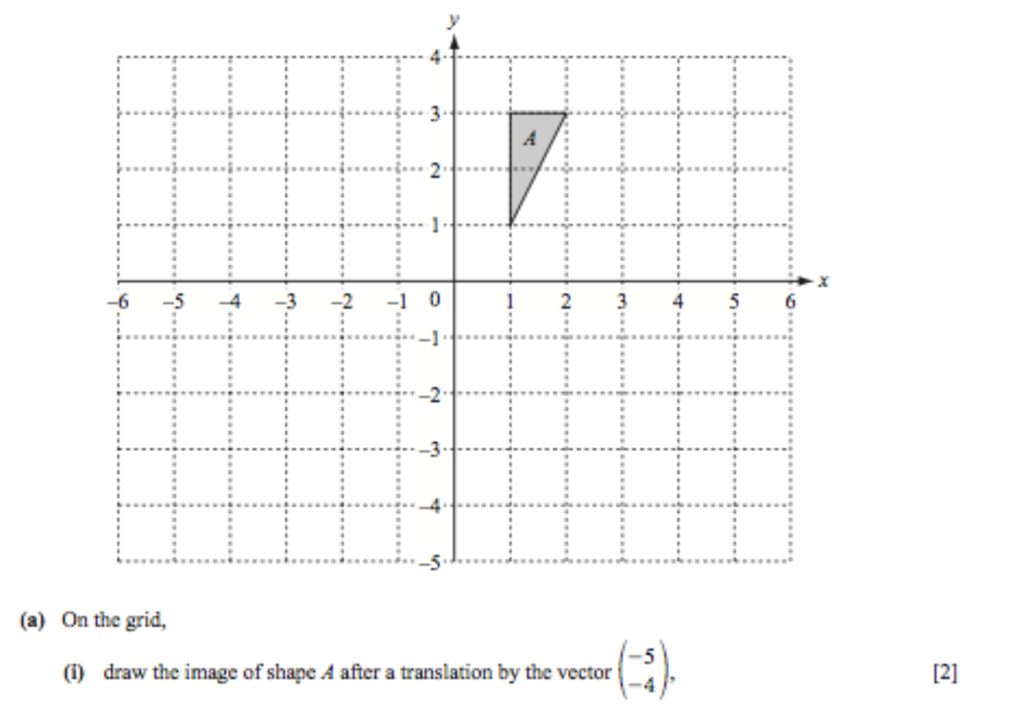
Translation

Slide 3
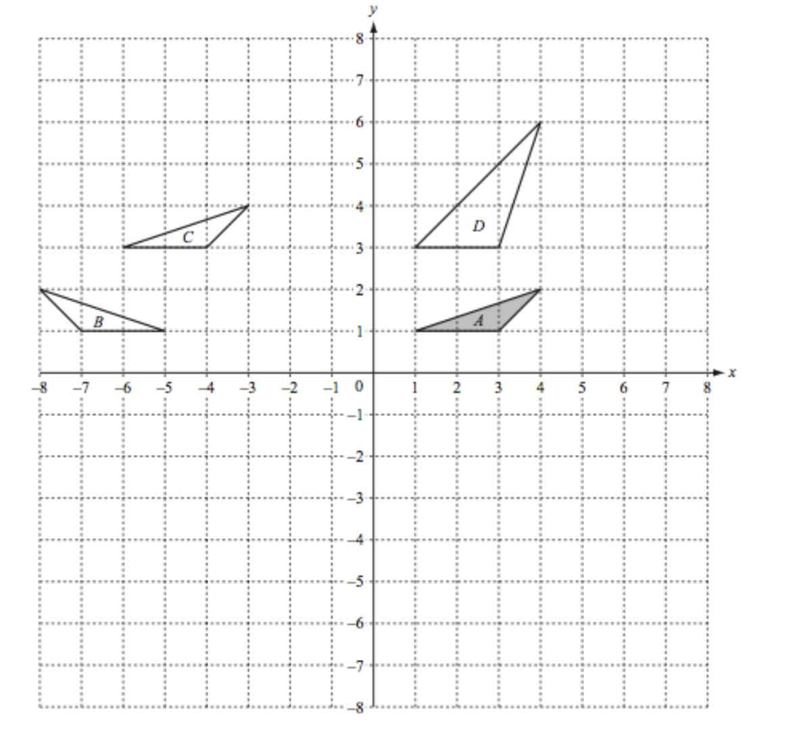
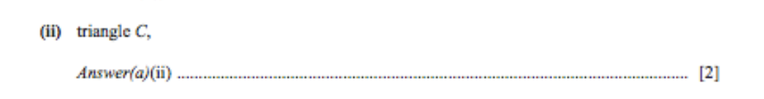

Slide 8
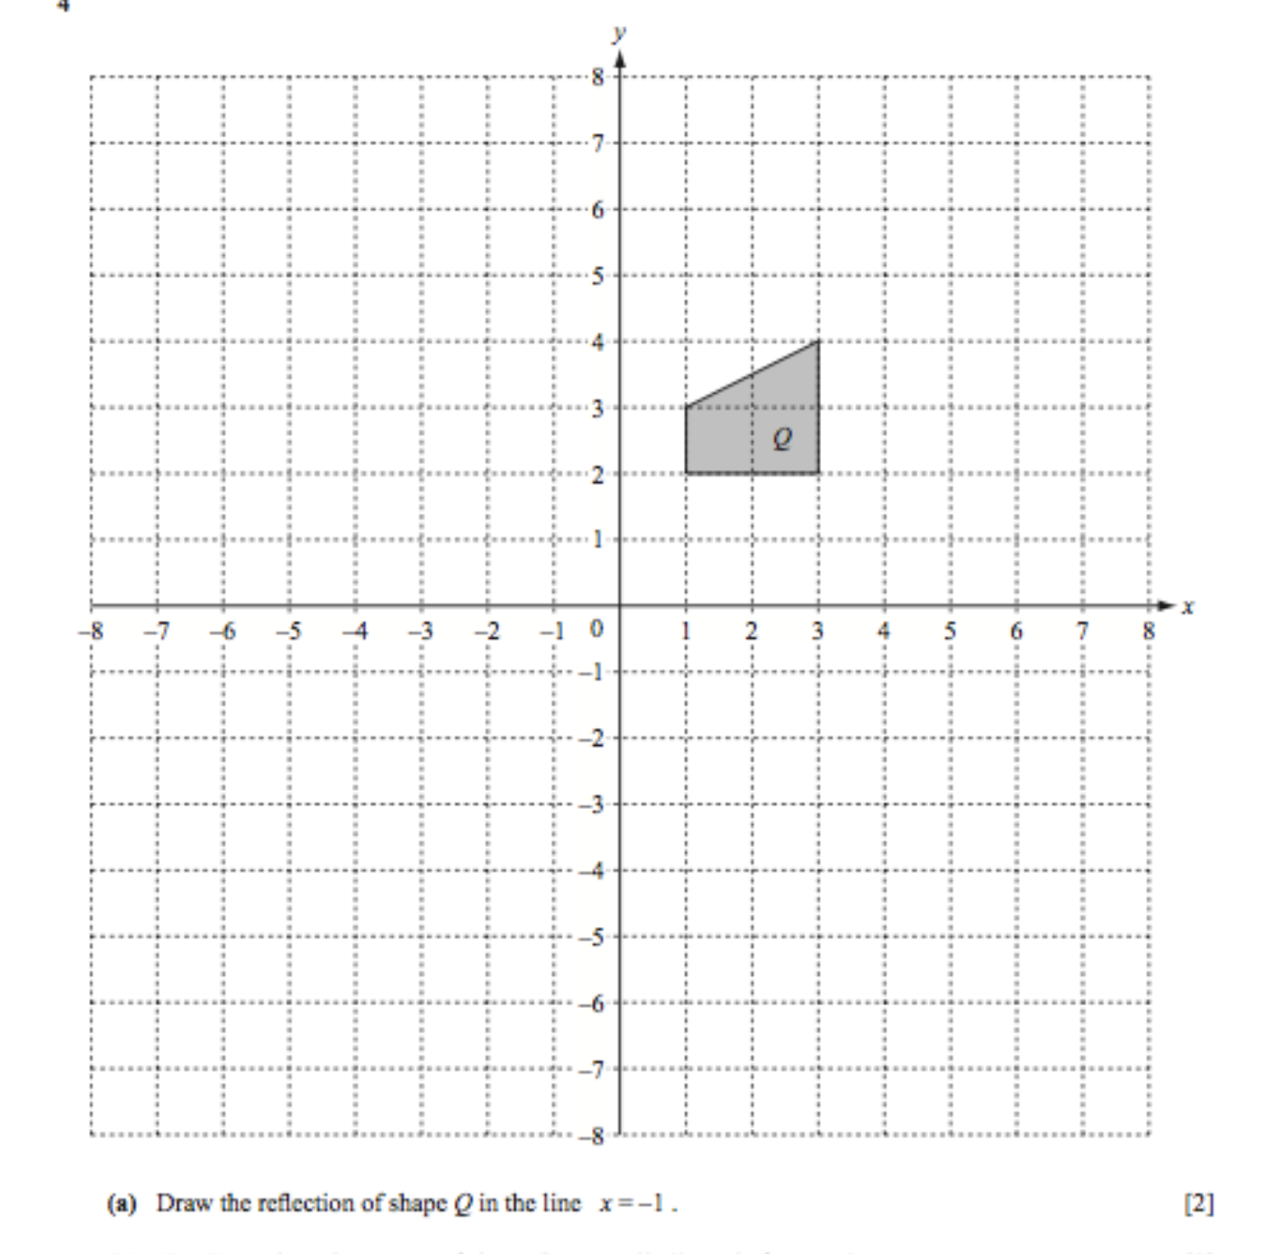

Slide 9
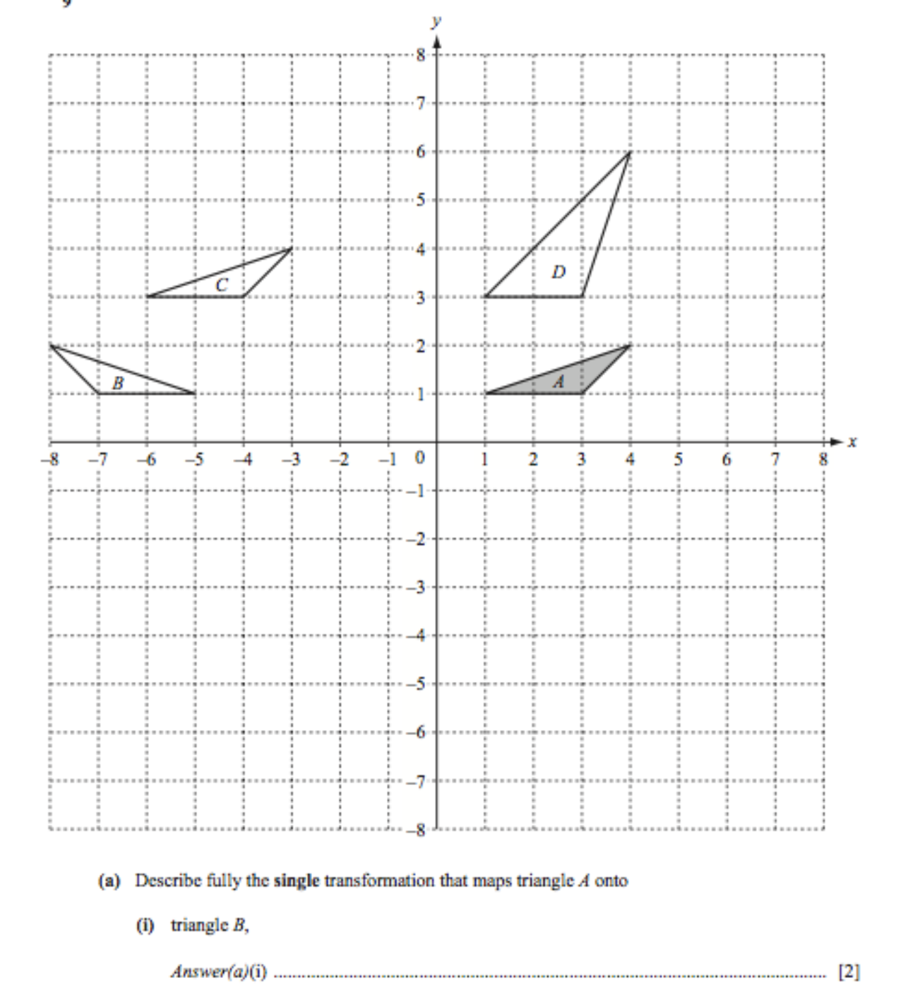

Slide 10
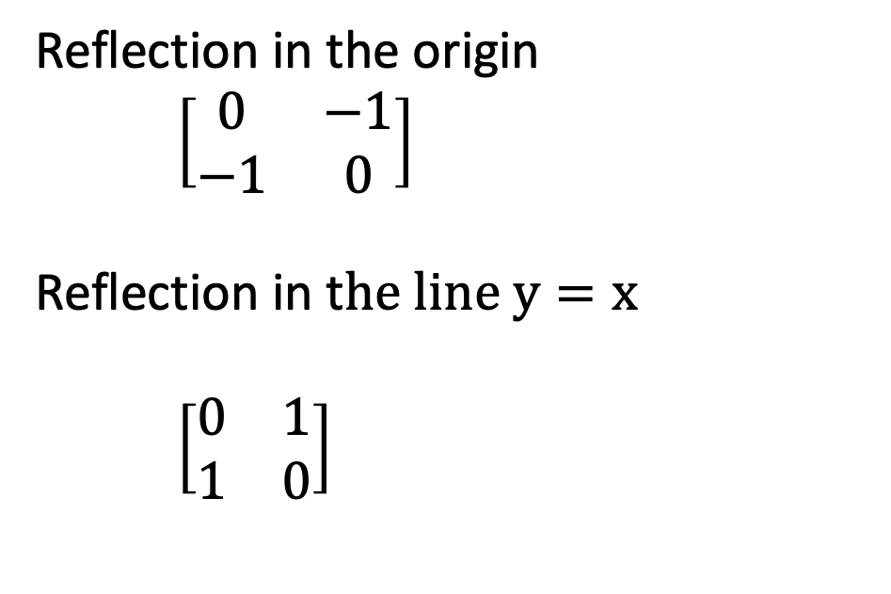
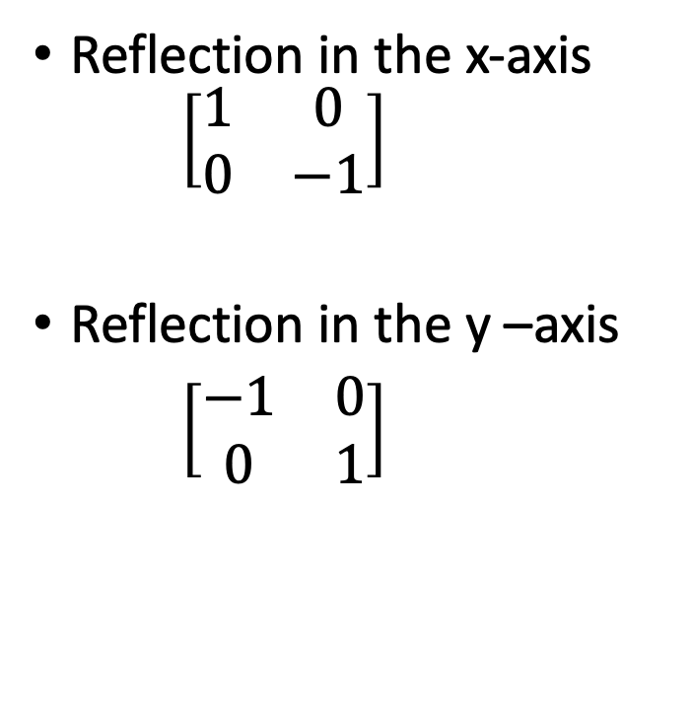
Matrix and reflection
Reflection in the x-axis $\left[\begin{matrix}1 & 0 \\ 0 & −1\end{matrix}\right]$
Reflection in the y –axis
$\left[\begin{matrix}−1 & 0 \\ 0 & 1\end{matrix}\right]$
Reflection in the origin
$\left[\begin{matrix}0 & −1 \\ −1 & 0\end{matrix}\right]$
Reflection in t$he line y=x$
$\left[\begin{matrix}0 & 1 \\ 1 & 0\end{matrix}\right]$

Slide 13
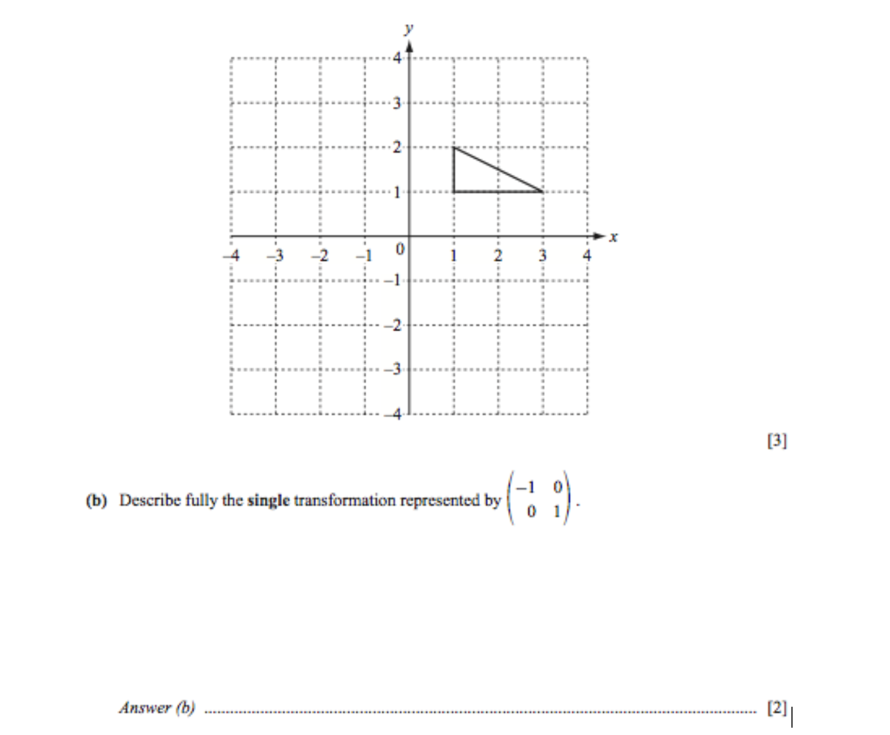

Slide 14
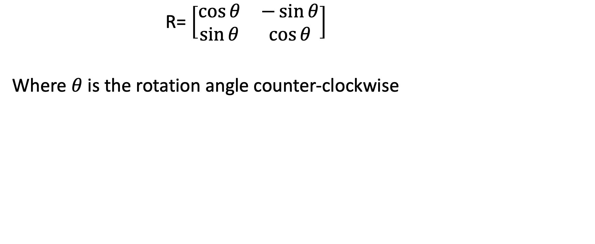
Rotational Matrix
R= $\left[\begin{matrix}\cos{θ} & −\sin{θ} \\ \sin{θ} & \cos{θ}\end{matrix}\right]$
Where $θ$ is the rotation angle counter-clockwise

Slide 15
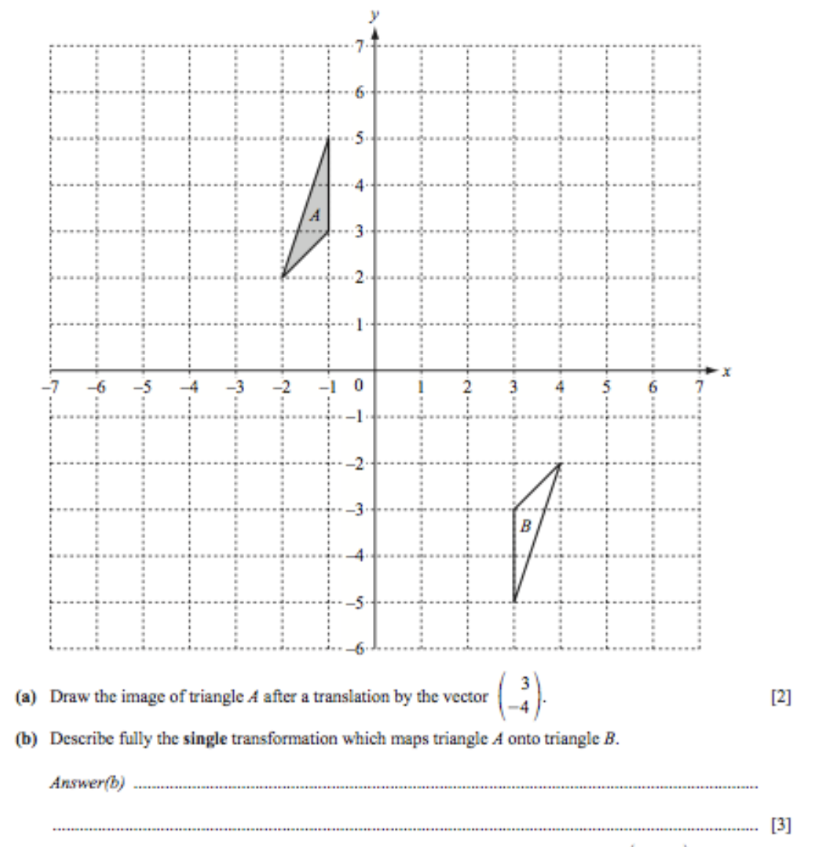
Name of transformation
Center of rotation
Rotation angle

Slide 16
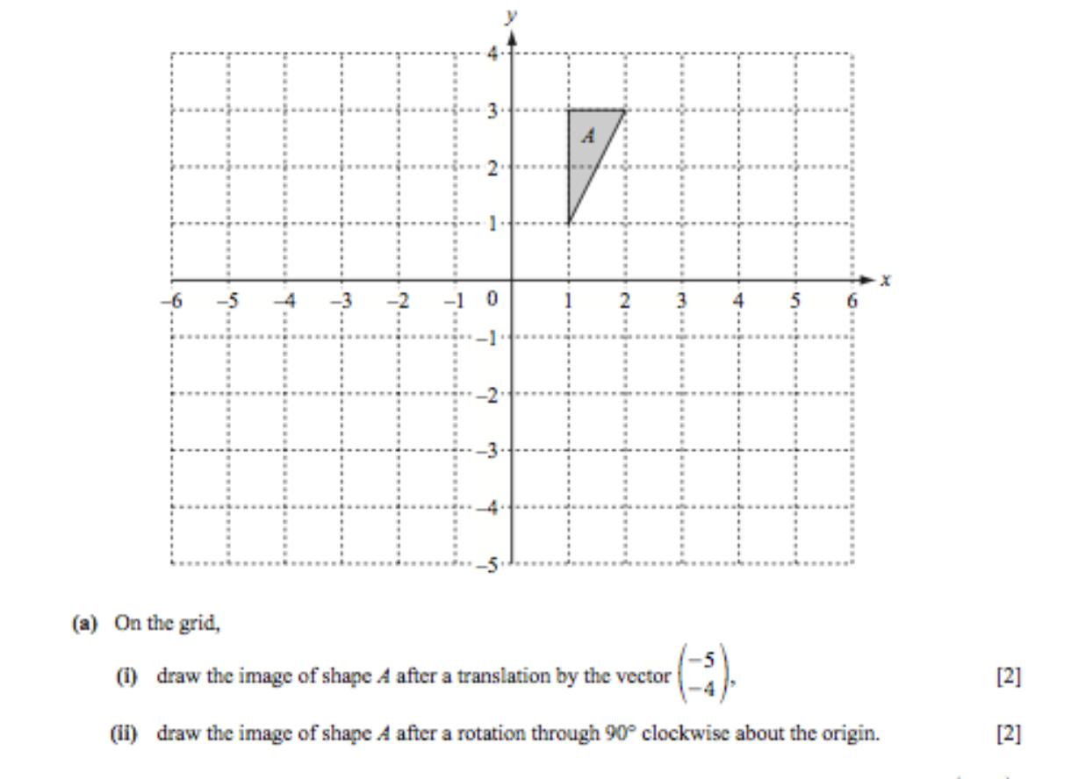

Slide 19
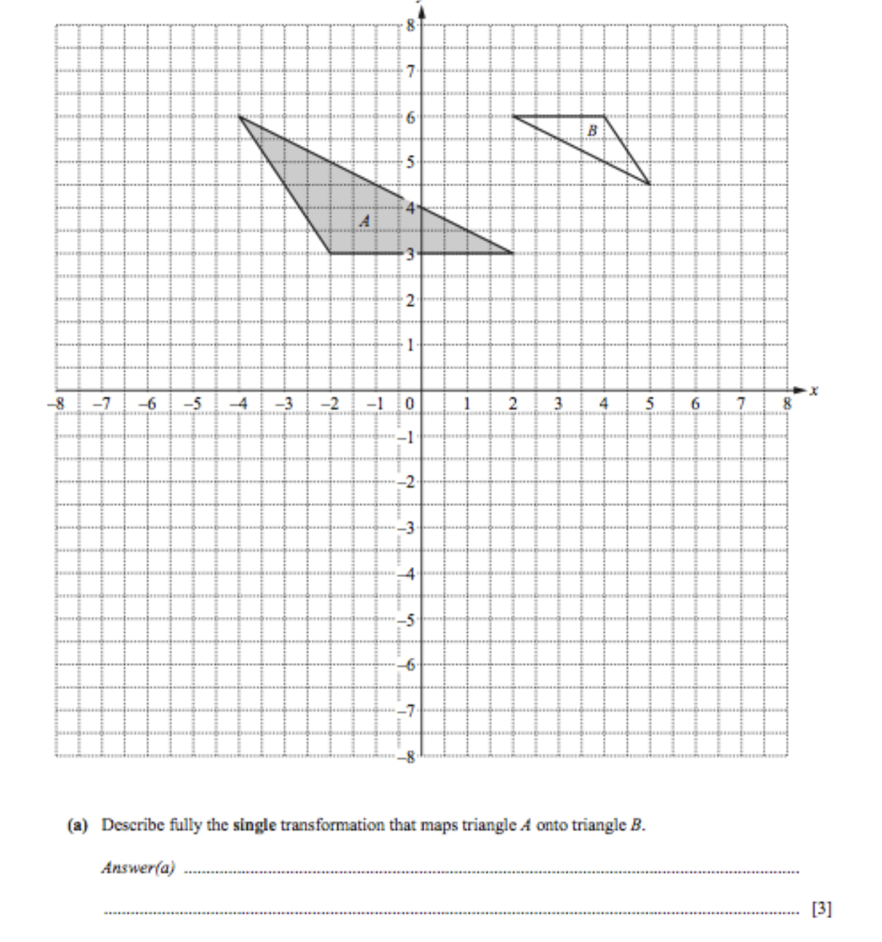
Name of transformation
Center of enlargement
Scale factor

Slide 20
